Slide 1


Logistic Regression
Hossam Ahmed Salah
MSP Helwan

Slide 2



Agenda
Classification
Logistic function
Odds
Logit
Log loss (cross entropy)
How to estimate the parameters?

Slide 3

Classification
Definition
Application

Slide 4

Classification
definition
In machine learning, classification is a supervised learning task where the goal is to predict the category or class of a given input data point. The input data point can be represented as a set of features or attributes, and the output is a class label that belongs to a predefined set of possible labels.

Slide 5
Classification model trained on labeled dataset where each data point has a class label.
Model learns patterns and relationships between input features and class labels.
Model uses this knowledge to predict class label of new, unseen data points.

Slide 6
Spam filtering: classify emails as spam or not spam based on their content and metadata.
Image recognition: classify images into different categories based on their visual features, such as identifying objects or faces in an image.
Sentiment analysis: classify text as positive, negative, or neutral based on its sentiment or emotion.
Fraud detection: classify transactions as fraudulent or legitimate based on their characteristics and patterns.
Medical diagnosis: classify patients into different disease categories based on their symptoms and medical history.
Customer segmentation: classify customers into different groups based on their demographic or behavioral characteristics for targeted marketing.

Slide 7
Logistic function
A line give quantities not classes !
Probabilities is what we need !
How to make a line Classify !
What is the sigmoid function?
Logistic function

Slide 8
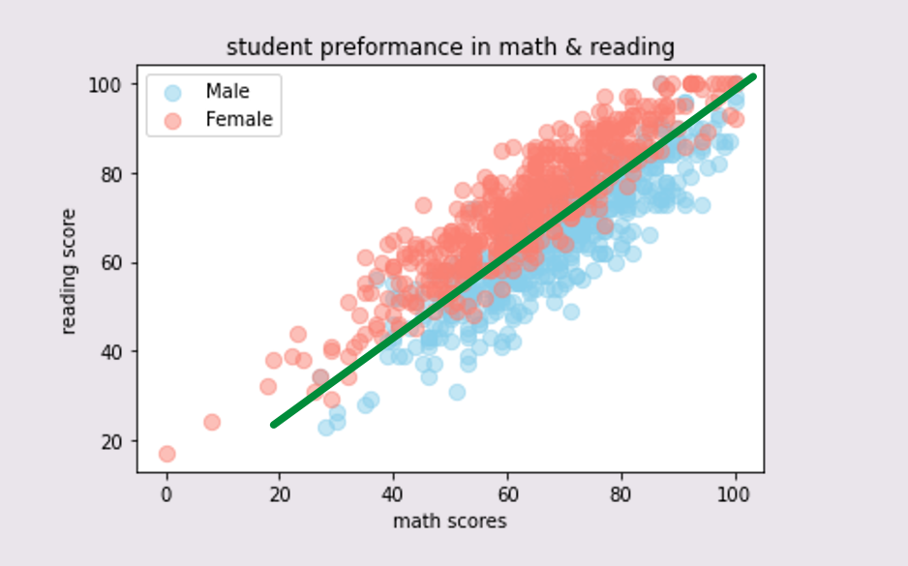
A line give quantities not classes !

Slide 9
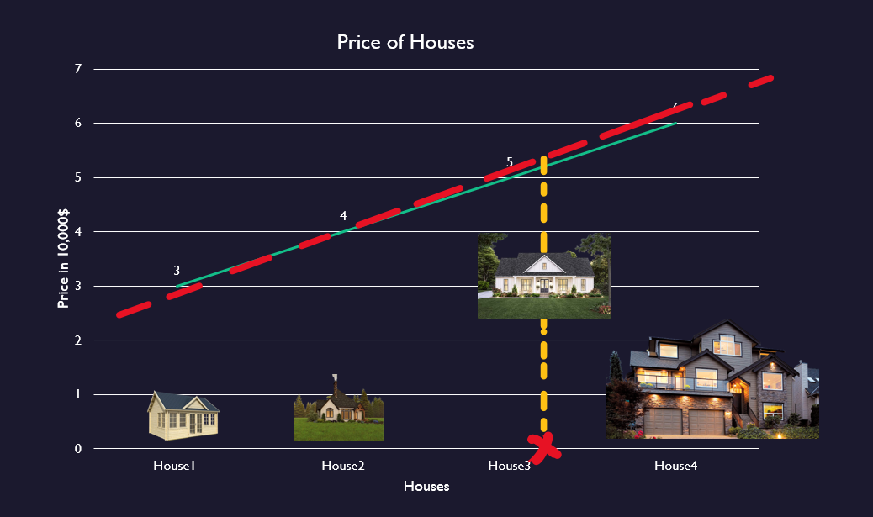
We input some features of the house
We got a quantity the Price 💵
Not classifying or answering a Yes , No question
Like Is It a GOOD house or BAD house?
A classification problem here can be is this house Big or small (e.g., from images)
Or Is this house luxury or not to which degree
Low , Mid , High
So, classification can be more than one class (discrete outcome)

Slide 10

Probabilities is what we need!
Our model need to give us probabilities
Probability of being Class1 is 0.6 so we can classify this observation to be Class1 based on the input features

Slide 11
How to make a line classify ?
Input features give us in a linear model a quantity like the price f(X{🏠,🛖,🏚️,🏡,🏘️}) = price💵

Slide 12
How to make a line classify ?
price💵can be helpful in answering a classification question Is this house Cheap or Expensive !! We classified the houses into two categories based on the output of linear mode a quantity !

Slide 13

How to make a line classify ?
So, we need a function that use the linear model to give us a probabilities
Model = P(y=${Class}_{i}$ |given features)

Slide 14
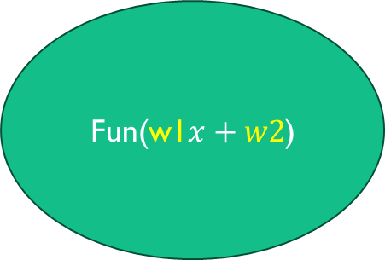
How to make a line classify ?
P(class1)
Expensive
Fun(w1$x+w2$)
P(class3)
Cheap

Slide 15
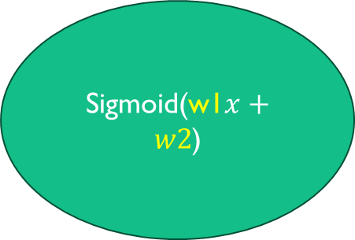
How to make a line classify ?
P(class1)
Expensive
Sigmoid(w1$x+w2$)
P(class3)
Cheap

Slide 16
What is the sigmoid function?
Sigmoid : are general mathematical functions that share similar properties: have S-shaped curves, map any real number to a probability between 0 and 1

Slide 17
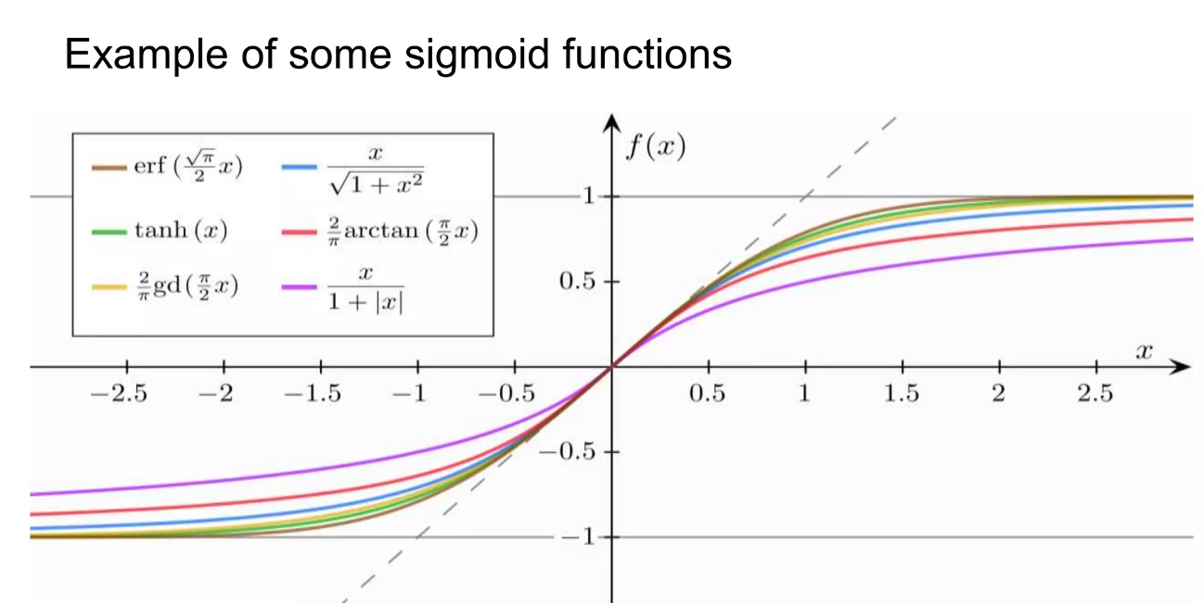
What is the sigmoid function?

Slide 18
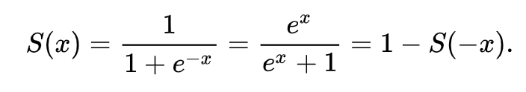
Logistic function

Slide 19
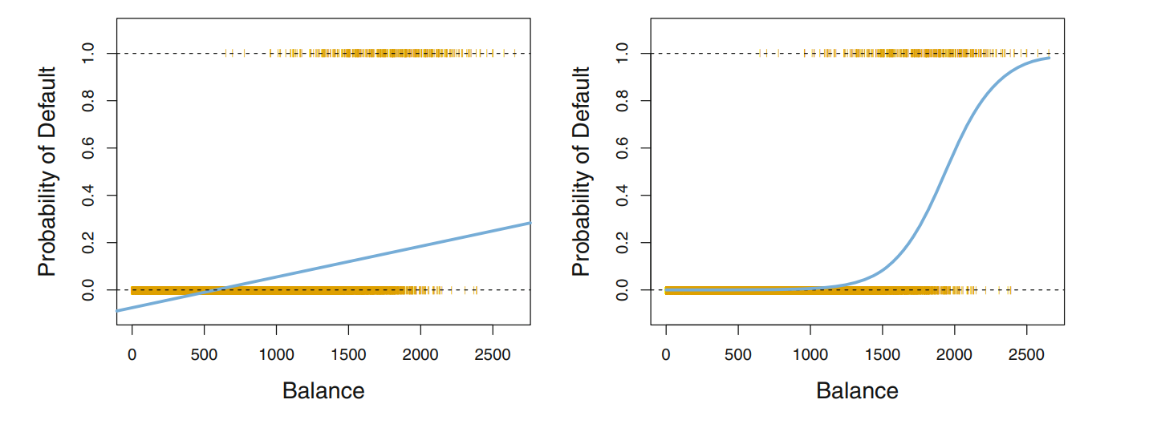

Slide 20
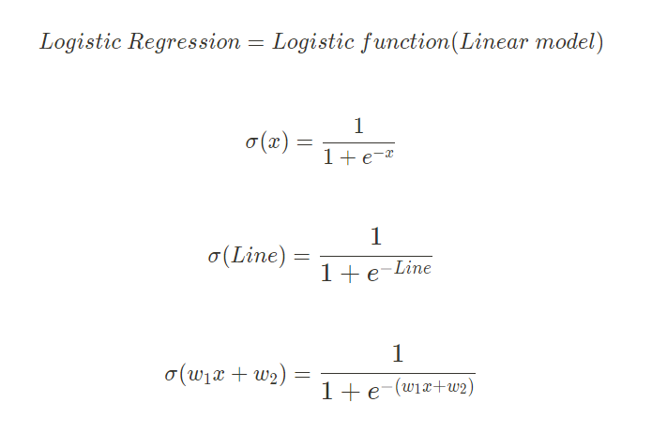
Simplification

Slide 21
ODDs
Logistic function is a probability
Odds definition
Odds math

Slide 22

Logistic outcome is a probability

Slide 23
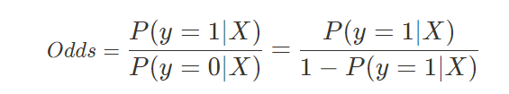
Odds definition
The meaning of ODDS is the probability that one thing is so or will happen rather than

Slide 24
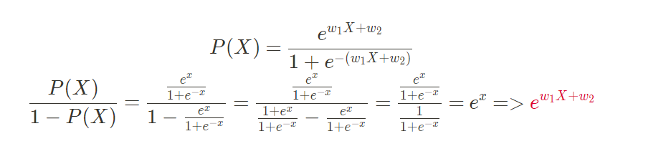
Odds math

Slide 25

Logit function
Inverse of the logistic function

Slide 26
Log Loss
Why not least square error with the logistic ?
Estimation of the parameters
It’s Bernoulli
Newton method

Slide 27
Why not using Least square error in logistic regression?
When choosing an Error evaluation function we need to take care of few things
This error function need to derivable and convex else when using gradient descent we may not find the global minimum of the error
Logistic transformation of the linear model make using MSE break these conditions as it’s no more a line
So , we are going to use a new criteria her called log loss

Slide 28
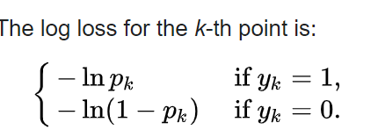

Log loss
$y_{k}$ the actual outcome of the $k^{th}$ observation
$P_{k}$ is the prediction of the class {0, 1}
Log loss is always greater than or equal 0
Equal to 0 only in case of perfect prediction
And approaches infinity as the prediction get worse
The logistic function is always strictly between zero and one , so the log loss is always greater than 0 and less than infinity
So it’s impossible to have in logistic regression zero at any point since $y_{k}$ is either 0 or 1 but $0<p_{k}<1$ means $P_{k}$ can’t equal exact 0 nor 1

Slide 29
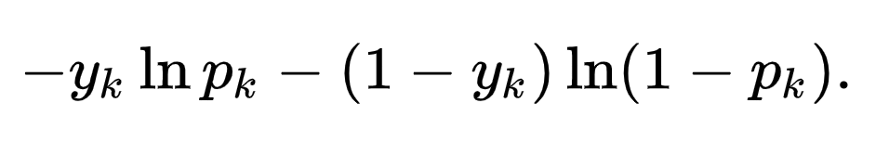
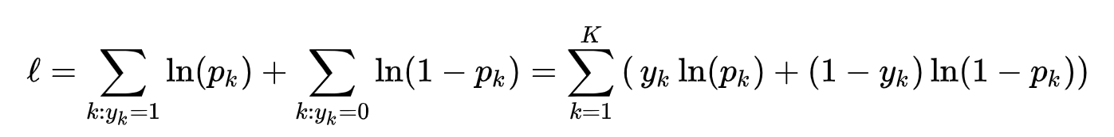



We can combine the two parts of the equation in this formula known as cross entropy
We sum the loss for all the k points , this called the overall negative likelihood $−l$and out target is to minimize the negative likelihood by finding the best weights of our model $w_{1}x+w_{2}$
Instead of minimizing the negative likelihood we can maximize the positive log likelihood
Or equivalent we can maximize the likelihood function which is the probability that the given data set is produced by a particular logistic function using MLE maximum likelihood estimation
Log loss

Slide 30
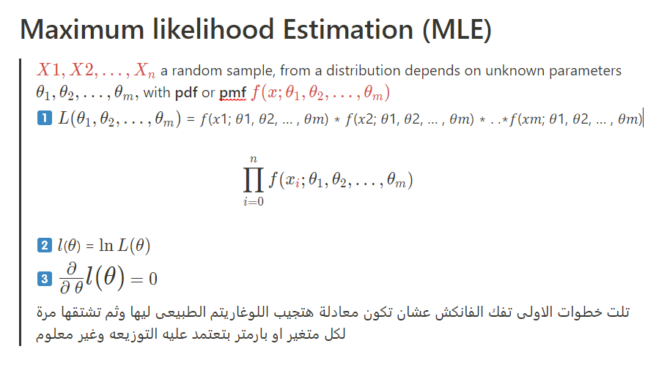
Estimation of the parameters
Estimation is just using a sample(s) to guess some thing about the complete population
Estimating a parameter based on a statistic

Slide 31
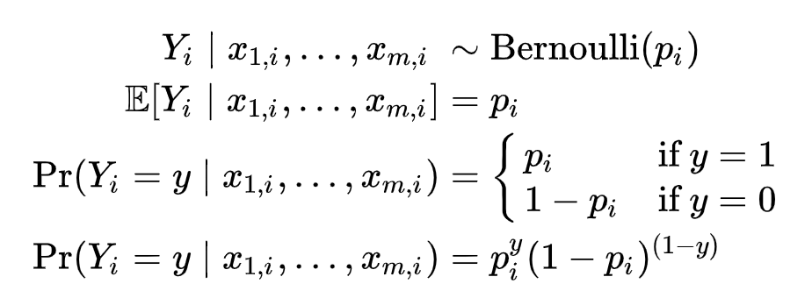
It’s a Bernoulli distribution
Y is a binary outcome success or fail for example
That why MLE using Bernoulli p.m.f to estimate the parameters

Slide 32
It’s a Bernoulli distribution
Y is a binary outcome success or fail for example
That why MLE using Bernoulli p.m.f to estimate the parameters

Slide 33
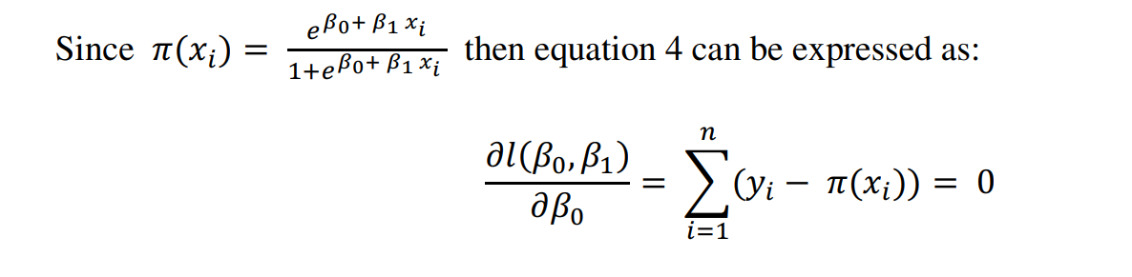
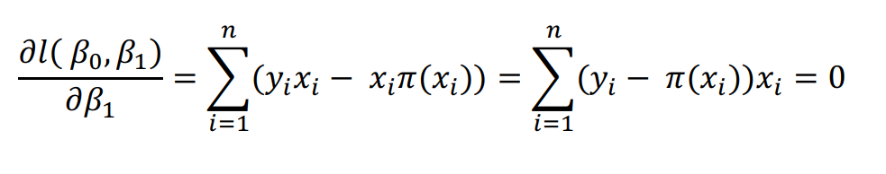

Without diving into math
The two equations are not in terms of $β$1 and $β$0, and are difficult to find the solutions analytically, then to obtain the values of their estimation we use an iterative way called Newton Raphson numerical iteration method

Slide 34
Newton method

Slide 35

References
https://en.wikipedia.org/wiki/Logistic_regression
https://towardsdatascience.com/intuition-behind-log-loss-score-4e0c9979680a
https://iopscience.iop.org/article/10.1088/1742-6596/1725/1/012014/pdf
https://en.wikipedia.org/wiki/Newton%27s_method

Slide 36

Thank You
Time for code

